Slide 1
Linearly dependent (線性相依)
Definition: 設 {u₁(x), u₂(x), ….u_{n}(x)}為定義於x∈[a,b]中的函數之集合
若函數可用其他 n-1 個函數之線性組合來表示時，則稱 {u₁(x), u₂(x), ….u_{n}(x)} 在x∈[a,b]中為線性相依
u₁=x, u₂=x+3, u₃=2x+3
因為 u₃=a₁u₁ + a₂u₂ with a₁=1, a₂=1
所以 u₁, u₂, u₃ 為線性函數

Slide 2
Linearly independent (線性獨立)
Definition: 設 {u₁(x), u₂(x), ….u_{n}(x)}為定義於x∈[a,b]中的函數之集合
若函數無法用其他 n-1 個函數之線性組合來表示時，則稱 {u₁(x), u₂(x), ….u_{n}(x)} 在x∈[a,b]中為線性獨立
u₁=x, u₂=x+3, u₃=x²
無法存在a_{1,} a₂ 使 u₃=a₁u₁ + a₂u₂
所以 u₁, u₂, u₃ 為線性獨立

Slide 3
跟解有關的定理: Theorem 1
n linearly independent solutions (y₁, y₂….y_{n}) will definitely exist to correspond to an n-th order linear homogenous ODE:
a_{n}y^{<n>}+a_{n-1}y^{<n-1>}, +…+a₁y’+ay = 0
通解為: y_{h}=c₁y₁+c₂y₂+c₃y₃+…….+c_{n}y_{n}
_{eg. y’’=0}

Slide 4
跟解有關的定理: Theorem 2
Conside an n-th order linearly non-homogenous ODE:
a_{n}y^{<n>}+a_{n-1}y^{<n-1>}, +…+a₁y’+ay = R(x)
If y_{p} is the particular solution:
a_{n}y_{p}^{<n>}+a_{n-1}y_{p}^{<n-1>}, +…+a₁y_{p}’+ay_{p} = R(x)
And y_{h} is the general solution of the associated ODE:
a_{n}y_{h}^{<n>}+a_{n-1}y_{h}^{<n-1>}, +…+a₁y_{h}’+ay_{h} = 0
then the general solution for the linear non-homogenous ODE is the addition of both y_{h and} y_{p}
Y = y_{h} + y_{p} = c₁y₁ + c₂y₂ + …+c_{n}y_{n} + y_{p}

Slide 5
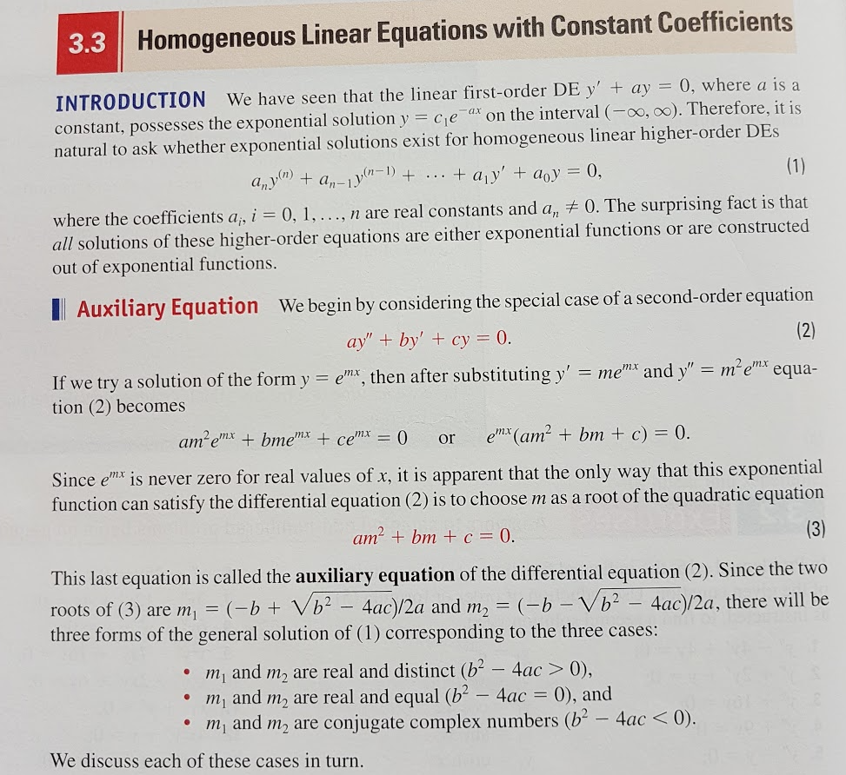

Slide 6
